Slide 1
D2L

Slide 2
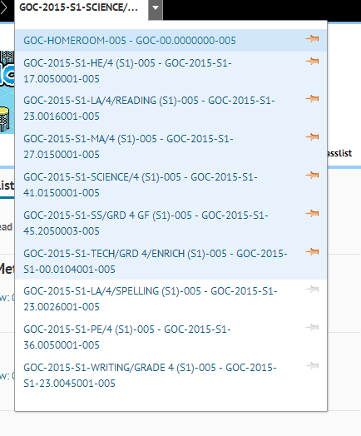
Online courses
You can get to your online
courses by locating them in your navigation bar
the navigation bar (or nav bar) is the
black strip at the top.

Slide 3
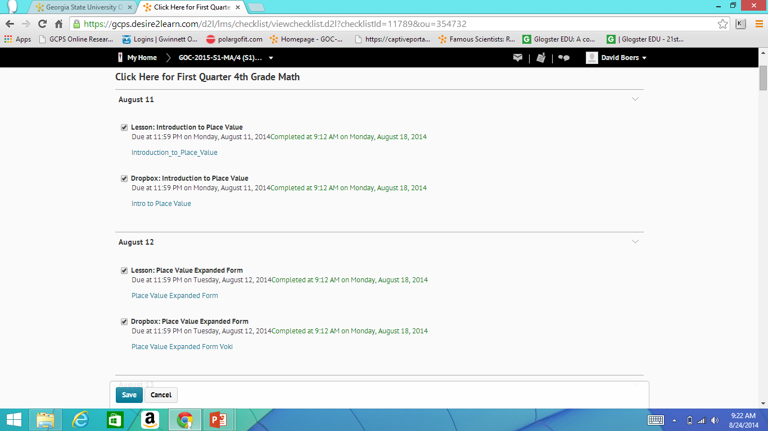
Checklist
This is the checklist

Slide 4
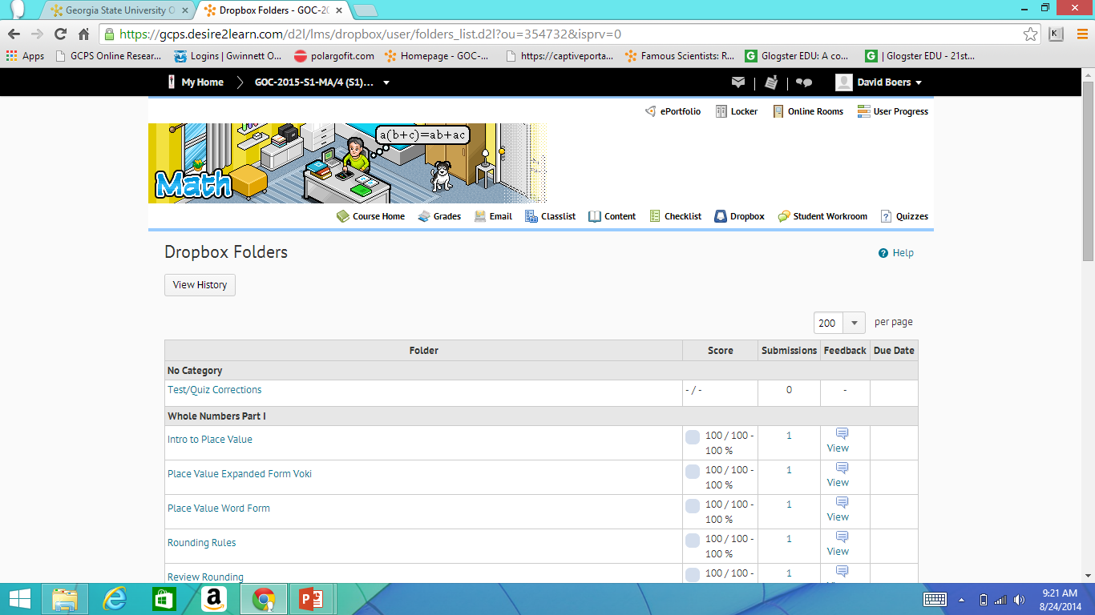
Drop box

Slide 5
Course information
We know how long you are on each course

Slide 6
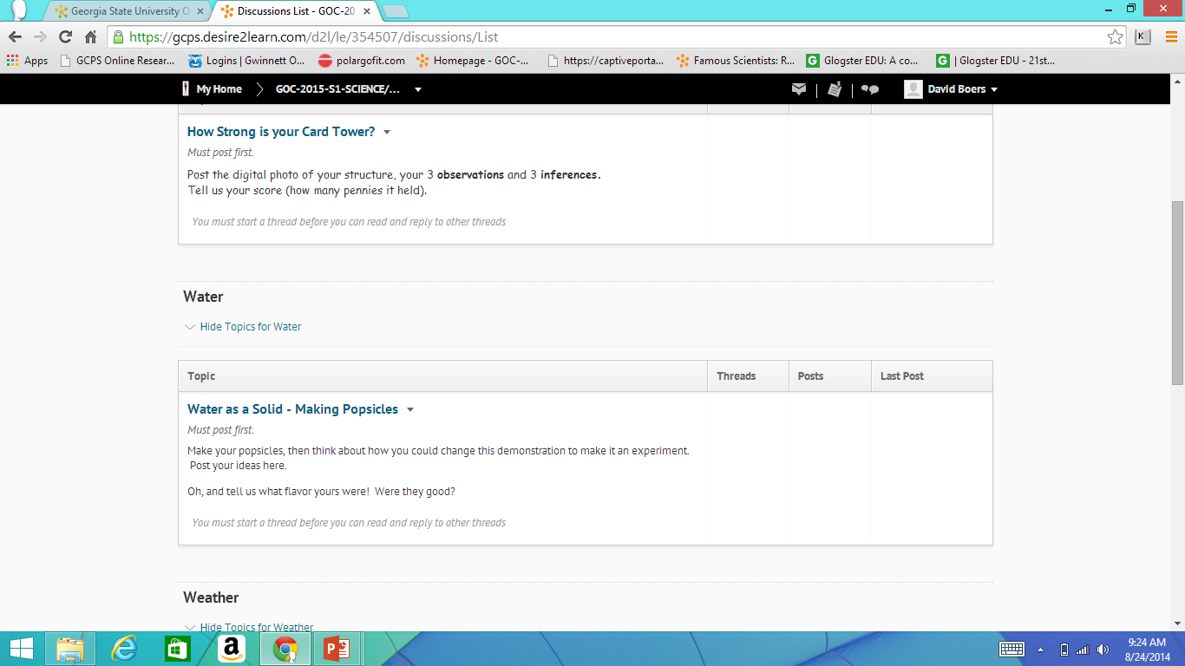
Student workroom

Slide 7
Other navigation
envelope
Sheet of paper
If there is a red circle at the corner of the envelope you have mail.
If the little pin at the top turns into a red dot you have news, if you click on it you can see this news.

Slide 9
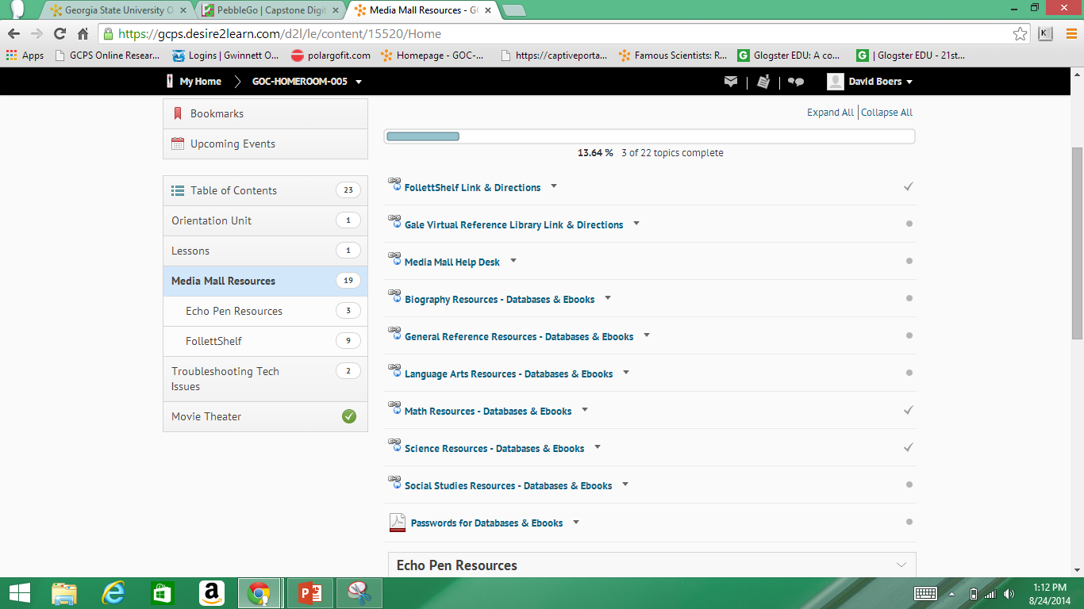
content

Slide 10
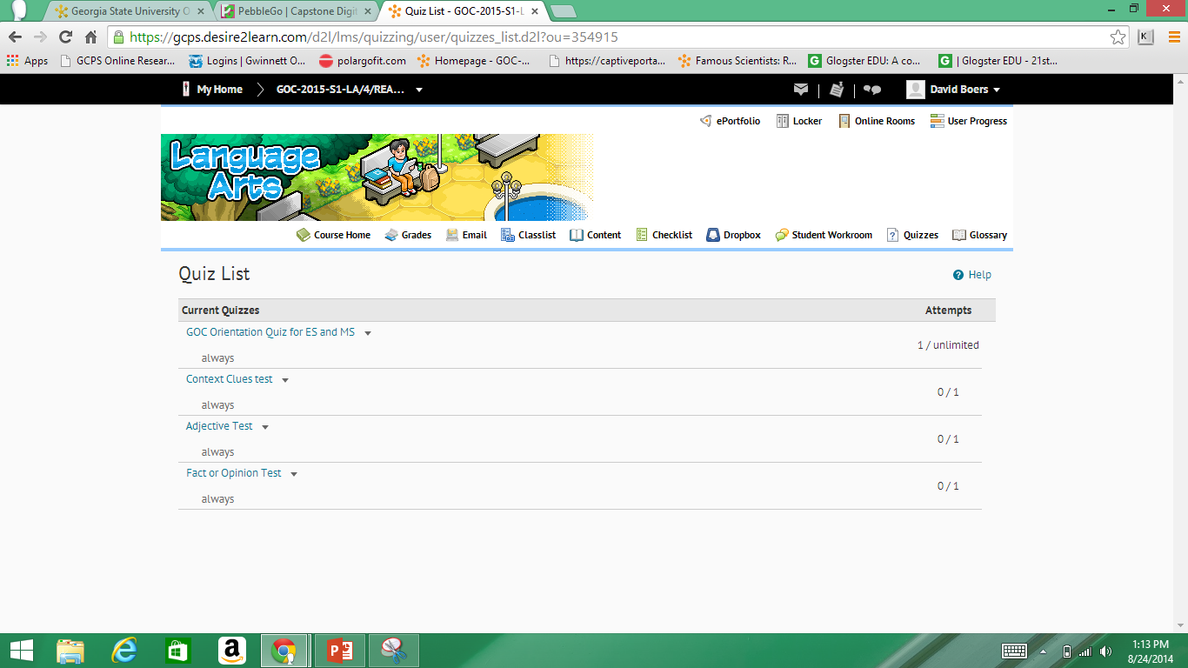
Quiz- the quizzes will come up when they need to

Slide 11
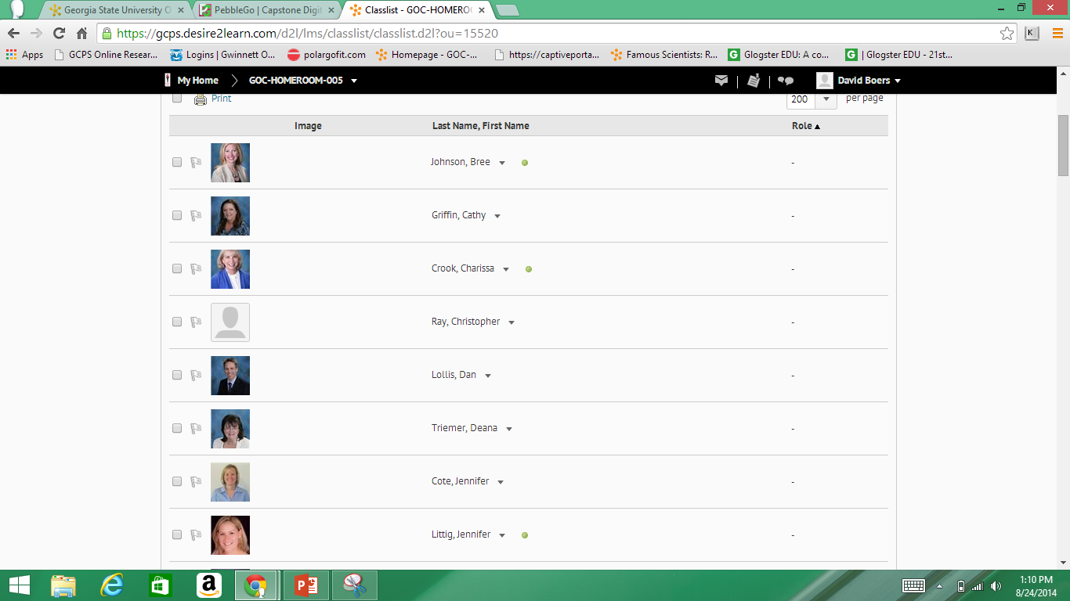
Classlist

Slide 12



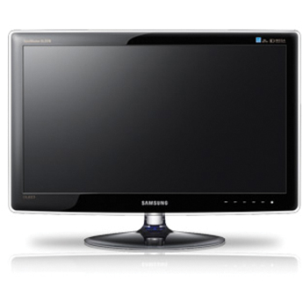
So the basics are
I recommend the below
Don’t forget to run the Setup wizard if you have headphones on.

Slide 13
Do not
Update things recommended by brightspot

Slide 14
The idea of brightspot
D2L
computers
time
fun/education/greatness

